Slide 1
Open House
Shannon Elementary
September 7, 2017

Slide 2
At Shannon Elementary, We LEAD
L: Love Learning
E: Excel In All We Do
A: Achieve
D: Do What Is Right

Slide 3
Our Beliefs
We believe that…
Each person has unique value and purpose.
Each person deserves to be treated with kindness and compassion.
Families and other core relationships are the foundation of communities.
A community is responsible for nurturing and empowering life-long learners.
Collaboration and diversity provide broader perspectives for richer outcomes.
People have the innate desire and ability to learn.
Learning is not constrained by time, place or method.
Change is constant; courage and adaptability determine our level of growth.
High expectations lead to high levels of success.
We are accountable to each other, our shared future, and ourselves.

Slide 4
About Shannon Elementary
Leader In Me Lighthouse School
2nd largest elementary in the district (702 students)
Campus Focus: Knowing Who Our Students Are & Where They Are Going

Slide 5
School Hours & Lunch Prices
Elementary Hours:
8:00 a.m.-3:00 p.m.
*Doors open at 7:15 a.m. First Bell rings at 7:45 a.m.
Tardy Bell rings at 8:00 a.m.
Lunch Prices:
Student Breakfast: $1.50
Student Lunch: $2.60
Adult: A-la-Carte

Slide 6
Grade Level Lunch Times
Kindergarten | 10:30-11:00 10:40-11:10
1st | 11:15-11:45
2nd | 11:00-11:30
3rd | 11:50-12:20
4th | 12:35-1:05
5th | 11:30-12:00
6th | 12:50-1:25
Structured Learning | 11:00
Life Skills | 11:00

Slide 7
Hug Zone
Students will be dropped at the door where our hug zone is. We welcome parents at Shannon but we must ensure ALL students are safe and that we are following district security and safety policies. If you are volunteering or meeting with a teacher, please do the following:
Check in at the front office with the Raptor system and our secretaries if volunteering. (Park and Enter through the Front Door)
If you need to meet with a teacher, please schedule an appointment so it does not interfere with instructional time.

Slide 8
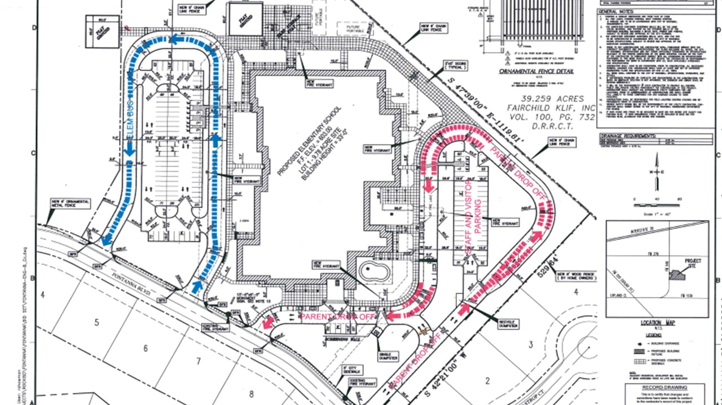
Drop Off and Pick Up
Back of Building
Front of School: Bus Drop Off/Pick Up
Side of Cafeteria: Car Drop Off and Pick Up
Fontanna Blvd.
enter

Slide 9
Drop Off (AM) & Dismissal (PM) Reminders
AM Drop Off
Please do not park near crosswalk
Please make sure your student is getting ready to exit car as you enter the parking lot.
Please do not go through the left lane (it is one lane), we have students who get out of the driver side and this causes a safety concern
Front entry is only if you are parking, please do not drop off students near bus lane
PM Pick Up
Great Job!

Slide 10
Transportation Changes
Please call the office with any transportation
changes by 1 p.m. if possible.

Slide 11
WATCH D.O.G.S.
WATCH D.O.G.S. is a one-of-a-kind, school-based father involvement program that works to support education and safety
Who are WatchDOGS? Fathers, grandfathers, step-fathers, uncles, and other father figures who volunteer to serve at least one day a year (more if able to) in a variety of school activities as assigned by the school principal or other administrator.
More information will be sent home about how to be a WATCH D.O.G.
If you are interested, you may sign up today to receive information about meetings.

Slide 12
PTA
The Shannon PTA is a wonderful opportunity for parents to be involved in supporting the school.
It is only $10.50 to join the PTA. You don’t have to commit any time, just your support for Shannon Elementary! Contact Kathy Wilson, PTA President, for more information on how to join! Information will also be going home with students the first week. If you join PTA you receive $5 off a shirt purchase.

Slide 13
Lunch Visitors
Lunch visitors will need to check in at the front office with the secretaries.
There are designated tables for lunch visitors. You may only sit with your child and bring your child food. We appreciate your support in this and know your child loves getting the treat of eating with you during the school day.

Slide 14
Communication
There are many ways to get updates on all that is happening at Shannon!
Follow us on Twitter @TheShannonStars
Our awesome staff has been tweeting fun pics, lessons, and activities going on around the school. Check out the #shannonstarsinspire and #shannonstarslearn
You can like us on Facebook: Sharon Shannon Elementary (this is a big communication tool for us with up to date information)
Stellar News: our school newsletter will come through email (as Skyward blasts) and the link will be posted on our website (under students-general information) & on Facebook

Slide 15
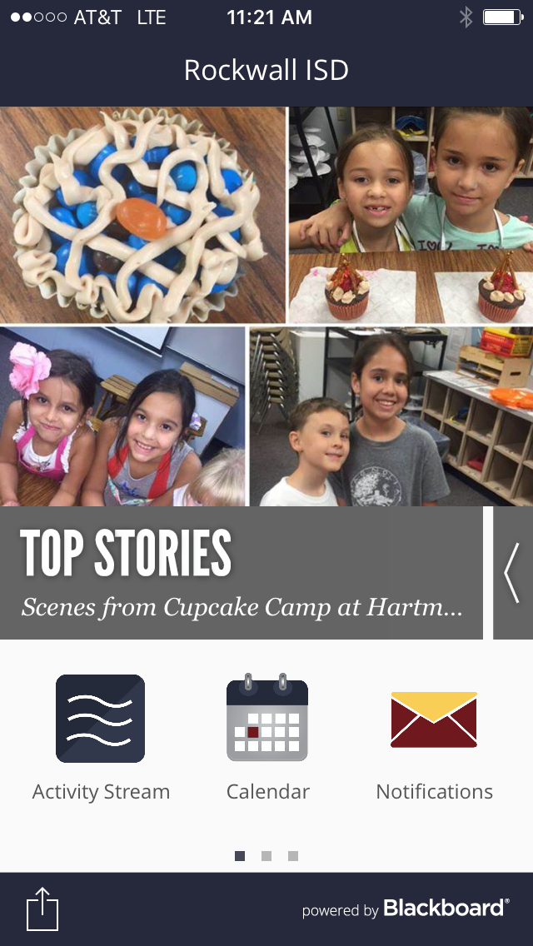
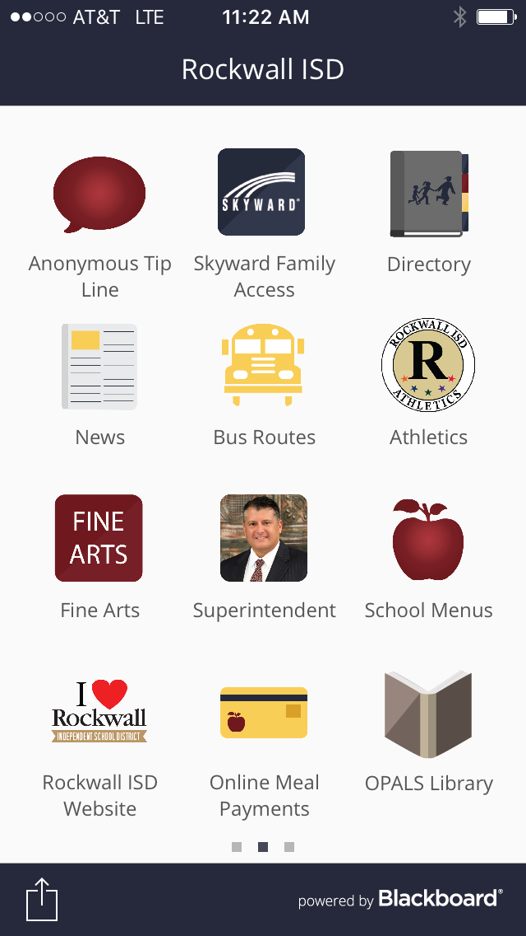
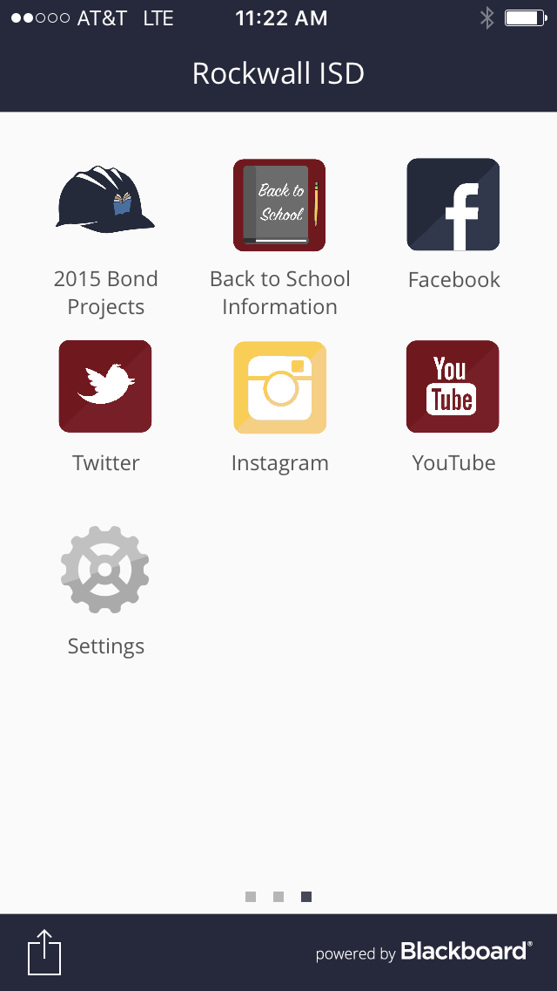
Amazing, New Rockwall ISD app. You have access to everything from one app!

Slide 16
Counselor’s Corner
Guidance
Student Support
Mrs. Ferguson provides support for students academically, emotionally, & socially.

Slide 17
Upcoming Events & Reminders
Grandparents Week Sept. 18-22
2nd Grade Swim Week Sept. 18-22
Fall Carnival Sept. 30th

Slide 18
Volunteer Information
We welcome volunteers. Some of the jobs that volunteers have helped with in the past have been:
-reading with students
-helping cover teacher classes while testing or on special days
-helping with lunch duties, book fairs

Slide 19
Questions/Concerns:
Please let us know if you have a question or concern. We want to provide support and address issues. It is important we work together! :)

Slide 20
We are here to serve our students and families.
We want nothing but the best for the students at Shannon Elementary.
We look forward to working together!

