Slide 1
Plate Tectonic Theory
Picture Vocabulary
Earth and Space

Slide 2
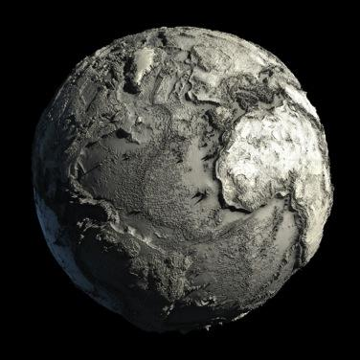
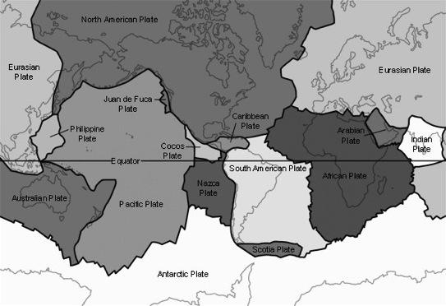
Plate Tectonic Theory
Theory that the lithosphere is divided into tectonic plates that slowly move on top of the asthenosphere.

Slide 3
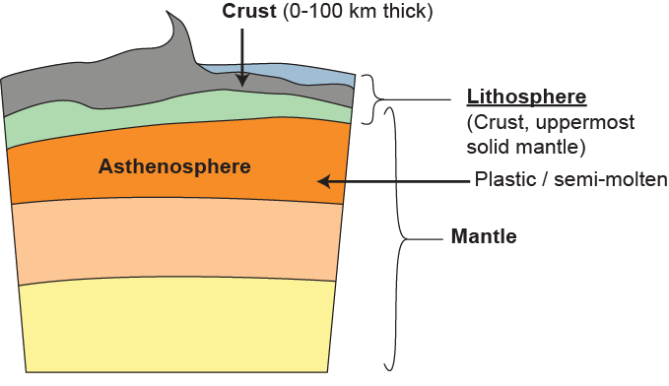
Lithosphere
core
Cool, rigid, outermost layer of Earth that is divided into enormous pieces called tectonic plates; consists of the crust and the rigid uppermost part of the mantle.

Slide 4
Asthenosphere
core
The solid layer with plasticity in the upper mantle that is located just below the lithosphere; lithospheric plates “float” and move on this layer.

Slide 5
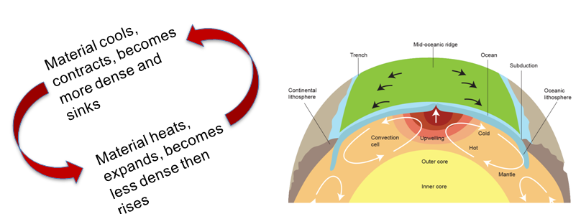
Convection Currents
A cyclical motion occurs because of density differences in the mantle. Heated, less dense lower regions of the fluid mantle rise, and denser, cooler regions sink due to gravity. The combined motions serve as the engine for crustal plate movement.

Slide 6
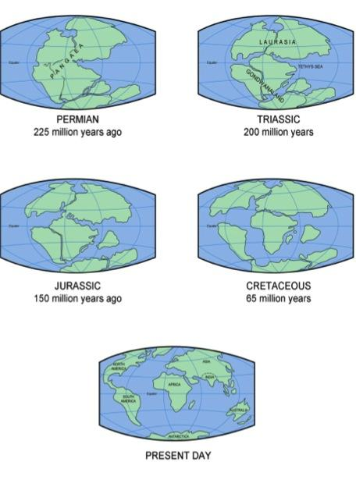
Continental
Drift
The theory that continents were once connected but have drifted apart.

Slide 7
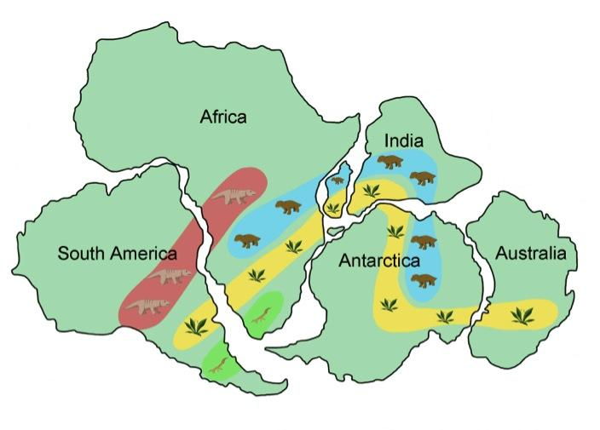
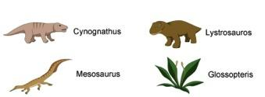
Fossils
Significant climate change indicated by fossils found in Antarctica suggest the continent was once much closer to the equator.
The mineralized remains of organisms, showing how long-dead organisms lived and how their bodies were structured.

Slide 8
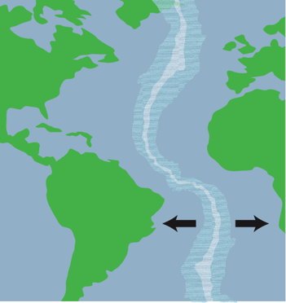
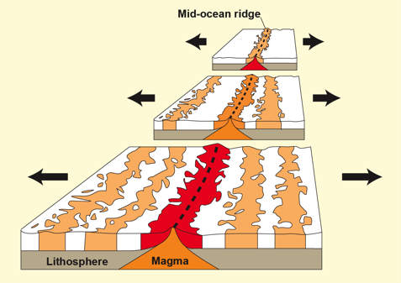
Sea Floor Spreading Evidence
A parallel pattern of rock material found at identical locations on each side of the Mid-Atlantic Ridge reveals rock of the same geologic age and polarity.

Slide 9
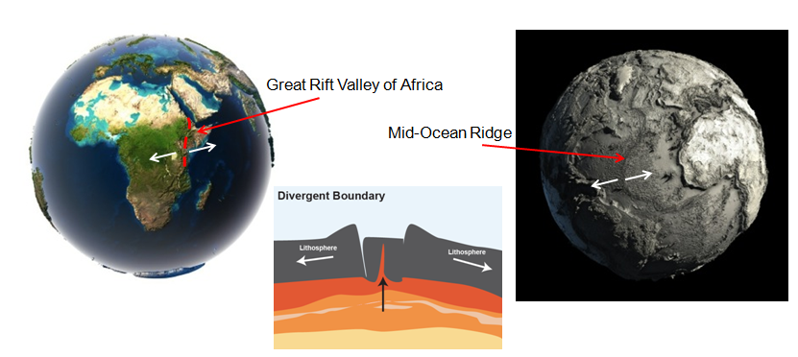
Divergent Boundary
Occurs when two tectonic plates move away from each other.

Slide 10
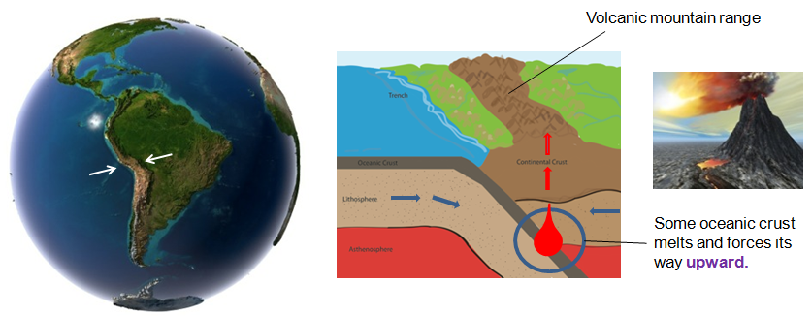
Convergent Boundary with Subduction
The boundary between two tectonic plates moving toward each other resulting in volcanic activity when a denser ocean plate subducts, or moves below a continental plate or another oceanic plate.

Slide 11
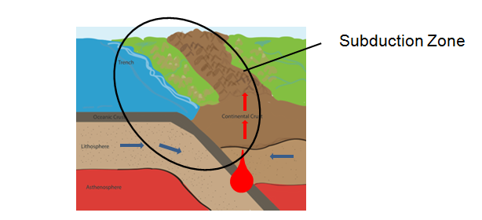
Subduction
The process in which a denser plate is pushed downward beneath a less dense plate when plates converge; occurs at continental to oceanic boundaries and oceanic to oceanic boundaries.

Slide 12
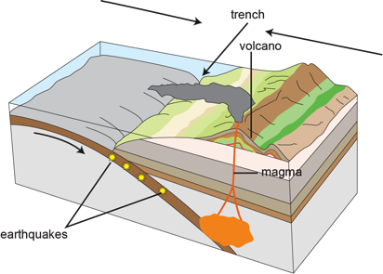
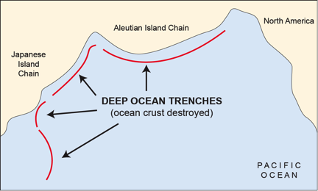
Ocean Trench
Deep and narrow depressions in the seafloor where the subducted plate moves into the asthenosphere.

Slide 13
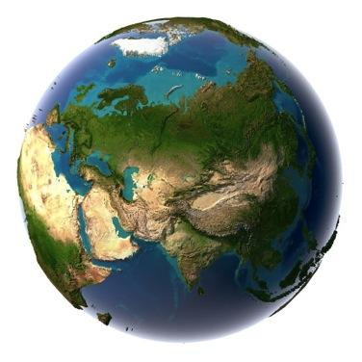
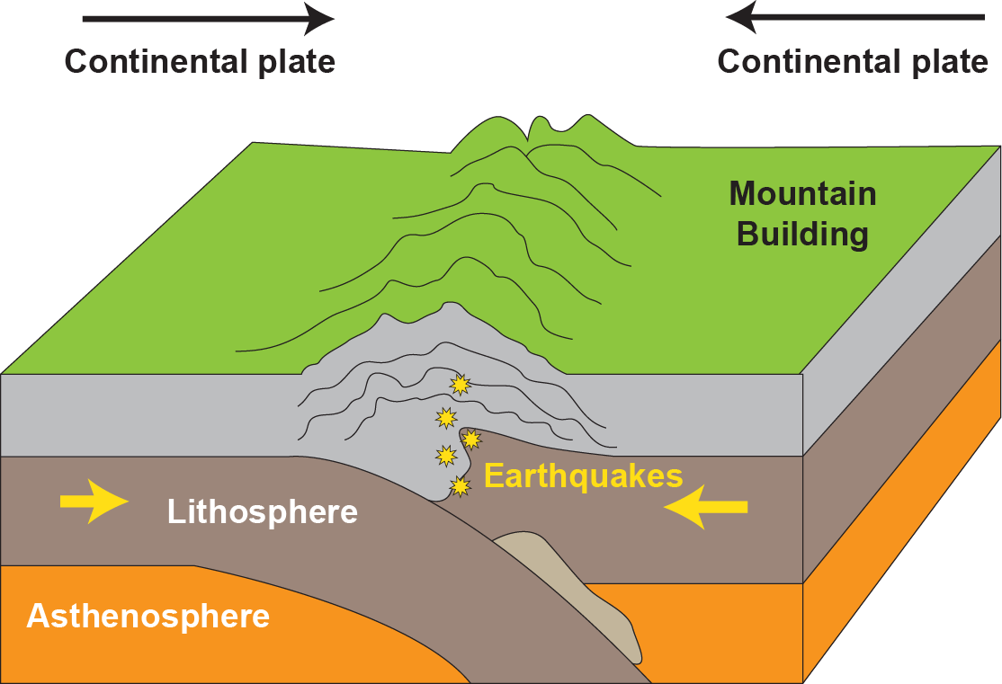
Convergent Boundary with Mountain Building
A major geological event; occurs when continental plates of equal density converge.

Slide 14
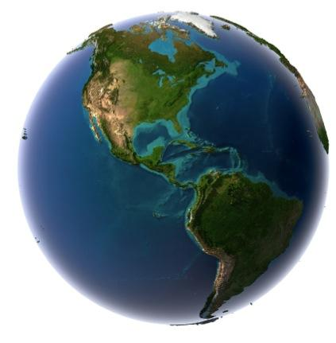
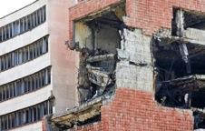
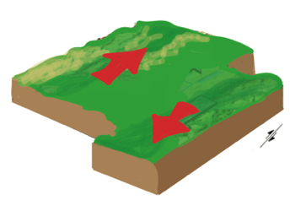
Transform Boundary
The boundary between two plates that slide past one another -- sudden shifts that result in major geological events such as earthquakes and the release of stored energy.

Slide 15
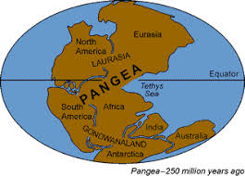
Pangea
The “Supercontinent” containing all continental land masses joined together.

Slide 16
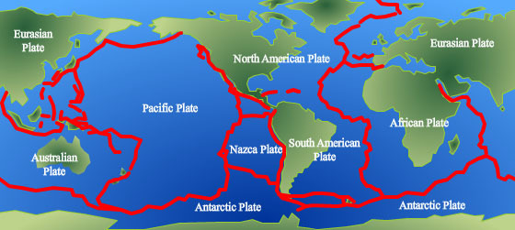
Boundary
Where two or more plates meet

Slide 17
Fault
Landform created at a transform boundary such as the San Andreas Fault in California

Slide 18
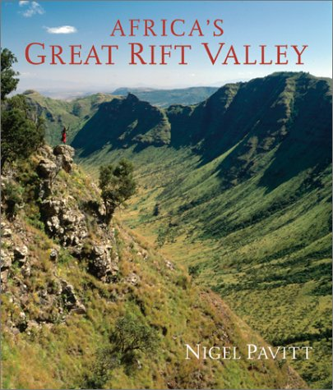
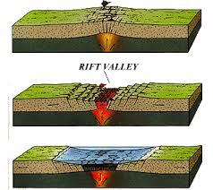
Rift Valley
Landform created at a divergent boundary on continental crust such as the Great African Rift Valley

Slide 19
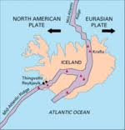
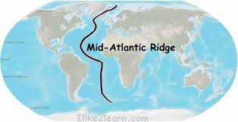
Ridge
Landform created at a divergent boundary on the ocean floor such as the Mid-Atlantic ridge

